Slide 1


Training on Integrated Progress Report
Renewable Energy – Annex II & XVI
Ph.D. Stephane QUEFELEC European Environment Agency
9 October 2025

Slide 2
Agenda
What to report: Overview of Reporting obligations on Renewable energy
Thematic aspects: Annex II - EEA
Thematic aspects: Annex XVI- EEA
Insight from EU Member States – VITO Belgium
How to report:
Reportnet 3 – EEA
Exercise - EEA
Logging in & set-up
Data input – overview
Data input – excel import
Data input – excel export
Quality assurance – validations
Release of data - submission
Notes:
13:00 – 14:45

Slide 3
Objective and expected result
=> At the end of the session, you will know WHAT to report and HOW to use the templates and the Reportnet 3 platform to report the data on Annex II and XVI.
Notes:
Stéphane QUEFELEC
Oskar GUSTAFSSON

Slide 4

Welcome
Your speakers for this meeting:
Stephane Quefelec– EEA – Climate Neutrality, Energy and Mobility (CMT 1)
Tom Dove – VITO – ETC/CM
For questions: Magdalena.Jozwicka@eea.europa.eu
Notes:
Stéphane QUEFELEC
Tom will present MS expereince in reporting Annex II.

Slide 5

National Energy and Climate Progress Reporting
Context

Slide 6



The Adapted Governance Regulation: planning & reporting
National Energy and Climate Plans
(NECP)
2018/9 & 2023/4 (+10yr)
(………….+5 yr)
National Energy and Climate Progress Report
(NECPR)
15 Mar. 2025 (+2yrs)
Adapted Governance Regulation 2018/1999: Article 3, 9, 14, 17

Slide 7
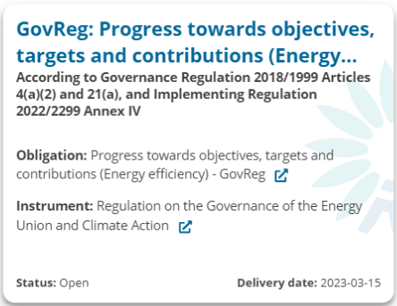
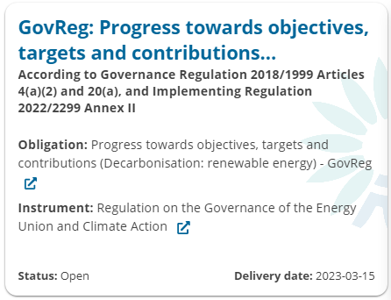
Energy Communities NECPR: EEA dataflow overview
Dataflow = a survey within the reporting platform containing information from particular reporting obligation(s) which can be submitted independently from other obligations.
GHG progress to targets
Annex I
Renewables progress to targets
Annex II
Energy efficiency progress to targets
Annex IV
Renewables additional obligations
Annex XVI
Energy efficiency additional obligations
Annex XVII
Reportnet 3

Slide 8
Dataflows in Reportnet 3: what are we focusing on today?
Many dataflows will be open soon for reporting in Reportnet 3:
NECPR – Progress to targets (GHG)
NECPR – Progress to targets (RES)
NECPR – Progress to targets (EE)
NECPR – Adaptation (Article 17)
NECPR – Additional reporting (RES)
NECPR – Additional reporting (EE)
Integrated National Policies and Measures (PaMs)
National systems for reporting on PaMs and projections
National GHG projections
Adaptation planning and strategies (Article 19)
European Climate Law Recommendations (*)
* This dataflow is aligned with NECPR but is voluntarily provided under the European Climate Law 2021/1119

Slide 9
Overview of prefilled / post-filled data in this dataflow
Annex II
Table 1
Table 2
Table 3
Table 4
Reported values
Prefilled
Eurostat SHARES
Eurostat SHARES
Eurostat SHARES
Eurostat SHARES
Post-filled
Table 5
Table 6
Table 7
Table 8
Calculated
Eurostat SHARES
Eurostat biomass questionnaire
Annex XVI
Table 1
Table 2
Table 3
Table 4
Table 5
Table 6
Table 7
Table 8
Table 9
Eurostat Energy balance
Notes:
Data that are already collected elsewhere at EU level and that are required in the NECPR dataflow are not asked to you again !
Data available at Eurostat data are pre-filled or post filled

Slide 10
Notation keys
What is a Notation Key?
A system to clarify lack of numerical data (where unavailable or not applicable).
Required for mandatory if applicable (Miap), if available (Miav), or voluntary (V) reporting.
Notation key | Description
NA | Not applicable - For data and activities in a reporting country that are not applicable or relevant to the context of the reporting country. Anticipated to be used in the context of Miap and V reporting fields. This notation key can be used instead of a value or 0, to ensure complete reporting.
NAv | Not available – For data and activities in a reporting country that are applicable to the context of the reporting country, however the data is not available. Anticipated to be used in the context of Miap, Miav and V reporting fields. This value can be used instead of a value or 0, to ensure complete reporting.
C | Confidential – Specifically for Annex II, Table 5, reporting on greenhouse gas savings performance of biofuels. This notation key is for data and activities in a reporting country that are available but are confidential and therefore cannot be reported publicly at a disaggregated level.
Import templates provide overview of when notation keys are accepted
For any issues check the reporting guidelines!
GHG (Annex I)
RES (Annexes II & XVI)
EE (Annexes IV & XVII)
Applicable to these dataflows

Slide 11

Annex II – Renewable energy
Thematic guidance

Slide 12
PROGRESS TO TARGET - Renewable Energy – legislation
Article 20 (a) – Progress towards objectives, targets, and contributions within renewable energy
By 15 March 2025 and every second year thereafter, CPs shall report to the Energy Community Secretariat their implementation of the following objectives within renewable energy: (1) overall/sectoral share of renewable energy in gross final energy consumption; (2) installed capacity from each renewable energy technology; (3) the contribution from each renewable energy technology in electricity, heating and cooling; (4) Biomass supply for energy use; (5) where applicable, other national trajectories and objectives, including those that are long-term and sectoral.
Reports due: | 15 March – Biannually – To start in 2025

Slide 13
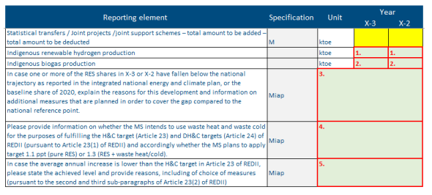
Annex 2 – Table 1
Sectoral (electricity, heating and cooling, and transport) and overall shares of energy from renewable sources
V
number (integer)
V
text
FIELD 1-2 :The purpose of this field is to provide the volume of indigenous renewable hydrogen and biogas production.
FIELD 3: in the case one or more of the RES shares in X-3 or X-2 have fallen below the national trajectory as reported in the integrated national energy and climate plan, or the baseline share of 2020, they have to explain the reasons for this development and provide information on additional measures that are planned in order to cover the gap compared to the national reference point.
Note: X is the reporting year
Notes:
I would say that they should compare to latest contribution (target) and trajectory to said contribution. But I understand some MS/CPs will not be comfortable with this as ESTAT data is REDII and updated NECPS are REDIII - if that's the case they can compare to final NECP (REDII) but they have to detail this in the descriptions they provide.
This is what DG ENER said in our training last week of January.
they need to compare with the Eurostat data (grey/yellow) fields with their NECP trajectory/contribution.

Slide 14
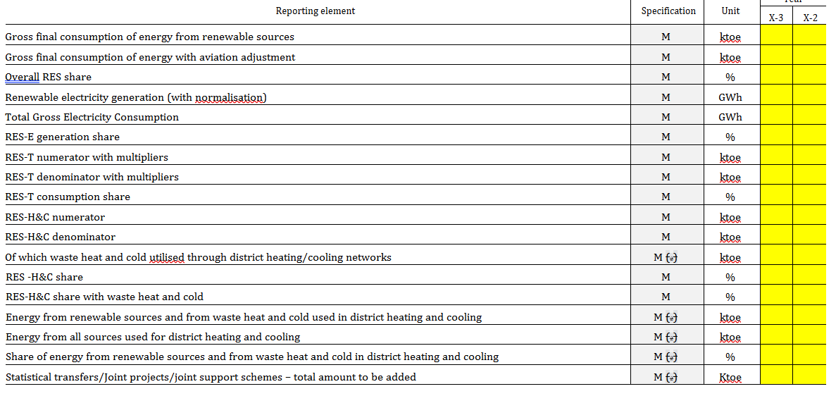

Slide 15
Annex 2 – Table 1
Sectoral (electricity, heating and cooling, and transport) and overall shares of energy from renewable sources
V
V
number (integer)
text
FIELD 4: to provide information about the use of waste heat and waste cold for the purposes of fulfilling the H&C target (Article 23) and DH&C targets (Article 24) of REDII and accordingly whether the MS plans to apply target 1.1 ppt (pure RES) or 1.3 (RES + waste heat/cold).
FIELD 5: in case the average annual increase is lower than the H&C target in Article 23 of REDII, to report the achieved level as a percentage and provide reasons, including of choice of measures (pursuant to the second and third sub-paragraphs of Article 23(2) of REDII).
Note: X is the reporting year
Notes:
Renewable Energy Directive II

Slide 16
Annex 2 – Table 2, 3 and 4
2 :Total installed capacity from each renewable energy technology
Relevant information, in case the evolution of installed capacity has an impact on the overall and sectoral trajectories for renewable energy from 2021 to 2030.
3 : Total actual contribution (gross electricity generation) from each renewable energy technology in electricity
Relevant information, in case the evolution of gross electricity generation has an impact on the overall and sectoral trajectories for renewable energy from 2021 to 2030.
4: Total actual contribution (gross final energy consumption) from each renewable energy technology in heating and cooling
Relevant information, in case the evolution of final energy consumption for heating and cooling has an impact on the overall and sectoral trajectories for renewable energy from 2021 to 2030.
(ALL big tables but most of this section will be pre-filled based on Eurostat SHARES data when available)
The purpose of this field is to provide relevant information, in case the evolution :
of installed capacity,
of gross electricity generation,
of final energy consumption for heating and cooling,
has an impact on the overall and sectoral trajectories for renewable energy from 2021 to 2030.
Note: X is the reporting year

Slide 17
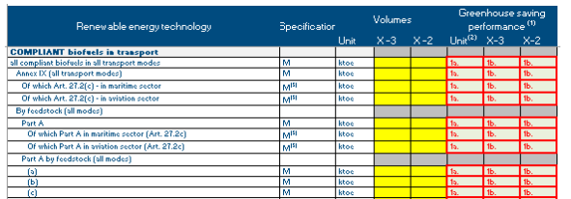
Annex 2 – Table 5
Total actual contribution (gross final energy consumption) from each renewable energy technology in the transport sector
The purpose of this field is to report the GHG savings performance for the different categories of biofuels used in transport
Most of this section will be pre-filled based on Eurostat SHARES data when available.
It is recommended that data provided here has the same unit for all rows. An example of a possible unit could be: Tonne CO2, kt CO2-eq.
FIELD 1a - 1b: Greenhouse saving performance has to be reported for the row “all compliant biofuels in all transport modes” (aggregated).
Note: X is the reporting year

Slide 18
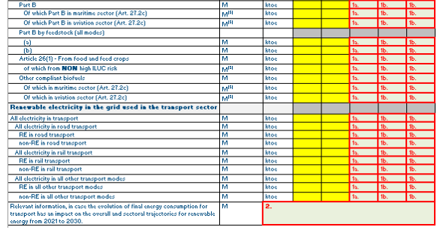
Annex 2 – Table 5
Total actual contribution (gross final energy consumption) from each renewable energy technology in the transport sector
FIELD 2: The purpose of this field is to provide relevant information, in case the evolution of final energy consumption for transport has an impact on the overall and sectoral trajectories for renewable energy from 2021 to 2030.
Note: X is the reporting year

Slide 19
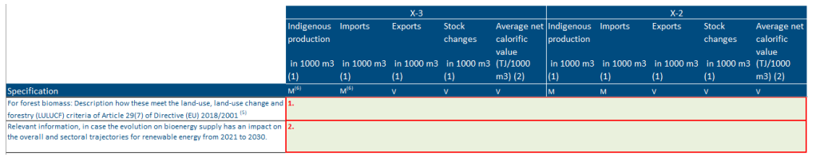
Annex 2 – Table 6
Biomass supply for energy use
Most of this section will be post-filled based on data from the Eurostat biomass questionnaire when available
FIELD 1: For forest biomass: Description how these meet the land-use, land-use change and forestry (LULUCF) criteria of Article 29(7) of Directive (EU) 2018/2001 (art 29 Sustainability and greenhouse gas emissions saving criteria for biofuels, bioliquids and biomass fuels);
FIELD 2: The purpose of this field is to provide relevant information, in case the evolution on bioenergy supply has an impact on the overall and sectoral trajectories for renewable energy from 2021 to 2030.
Note: X is the reporting year

Slide 20
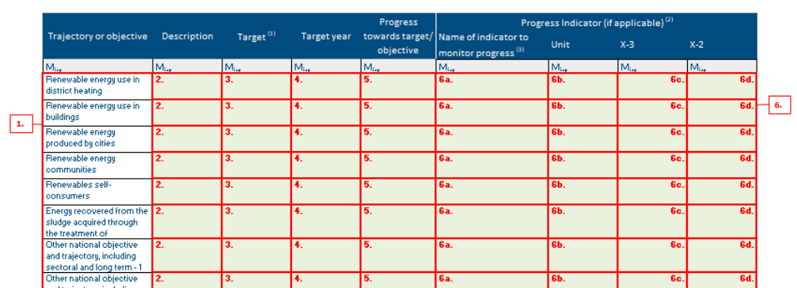
Annex 2 – Table 7
Other national trajectories and objectives
FIELD 1:The purpose of this field is to identify the other national trajectory or objectives set to increase the share of energy from renewable source in gross final consumption of energy in 2030, from 2021 onwards.
They have to integrate in their report other national trajectory and objectives, including those that are long-term and sectoral, for which a trajectory or an objective has been set at national level, different from the national contributions set in their NECP.
Note: X is the reporting year

Slide 21
Annex 2 – Table 7 - Example
Other national trajectories and objectives
Good Example:
Share of renewables in heating and cooling networks in Germany.
The German Federal Government intends to achieve a further increase in the share of renewables in heating and cooling networks. According to the recast Renewable Energy Directive, the EU CPss are obliged to work towards an annual increase of 1% in the share of renewables in heating networks between 2020 and 2030 (calculated as a yearly average for the periods 2021- 2025 and 2025-2030). This ambitious goal is also defined in the NECP. The expected share of renewables in heating networks in 2021 is accordingly around 21%, with the figures for 2025 and 2030 being 25% and 30% respectively.
Note: X is the reporting year

Slide 22
Annex 2 – Table 8
Assessment of the support for electricity from renewable sources pursuant to Article 6(4) of Directive (EU) 2018/2001
The purpose of this field is to report on the effectiveness of CPs’ support schemes for electricity from renewable sources and their major distributive effects on different consumer groups, and on investment.
The effect of the implemented supports for electricity from renewable sources needs to be presented in this field. The CPs will provide information on concerned policies and measures developed.
The description have to also include references to concerned PaMs set providing support for electricity from renewable sources. PaMs have to be referred with references/links to direct users to documents and website.
Note: X is the reporting year
Notes:
In accordance with Articles 7 to 13 of Directive 2018/2001/EU, CPss to decide to which extent they support electricity from renewable sources which is produced in another CPs. They may also open participation in support schemes for electricity from renewable sources to producers located in other CPss.

Slide 23
Agenda
What to report: Overview of Reporting obligations on Renewable energy
Thematic aspects: Annex II - EEA
Thematic aspects: Annex XVI- EEA
Insight from an EU Member State – VITO Belgium
How to report:
Reportnet 3 – EEA
Exercise - EEA
Logging in & set-up
Data input – overview
Data input – excel import
Data input – excel export
Quality assurance – validations
Release of data - submission
Notes:
13:00 – 14:45

Slide 24
Annex XVI – Additional reporting on RE
Thematic guidance

Slide 25
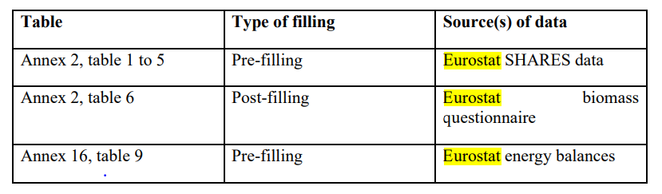
ADDITIONAL REPORTING - Renewable Energy - legislation
Article 20 (c) – Additional reporting obligations in the area of renewable energy
By 15 March 2025 and every second year thereafter, CPs shall report to the Energy Community Secretariat: (1) functioning of Guarantees of Origin (GO) system for electricity, gas and heating and cooling; (2) estimated excess / deficit in renewable energy projection compared to trajectory; (3) biomass usage functioning and effects on the country; (4) production and use of renewable energy in buildings.
Reports due: | 15 March – Biannually – To start in 2025
The process for pre-filling, pre-loading and post-filling of data
Key def: A Guarantee of Origin is an electronic certificate that proves that a certain amount of electricity was produced from renewable energy sources (or, in some cases, high-efficiency cogeneration).
Notes:
GO are guarantees of origin and they are reported in Table 1 for electricity, gas and heating. AiB is an European organization (Association of issuing bodies) and almost all countries (of the 27 MS) are included in it. AiB publishes yearly values of how many guarantees of origin were issued for each member country. AiB also does some oversight and harmonization of GO certification. Statistics that a MS reports is not identical to what is on AiB – due to two reasons – first is that time period of reported GO is not explicitly specified (it is 1 year, but that year can be from 1.1. to 1.1. or perhaps 1.10-1.10. and second, there are methodological options of what exactly to include in GO – for instance nuclear energy may be included or not, it is up to MS). Therefore we are limited to checking if reported value is close value in AiB.
In this table we also have resulting renewable energy consumption – this we compare with value calculated based on reported canceled (used) GO for electricity, residual mix reported by AiB and total electricity consumption from EUROSTAT.

Slide 26
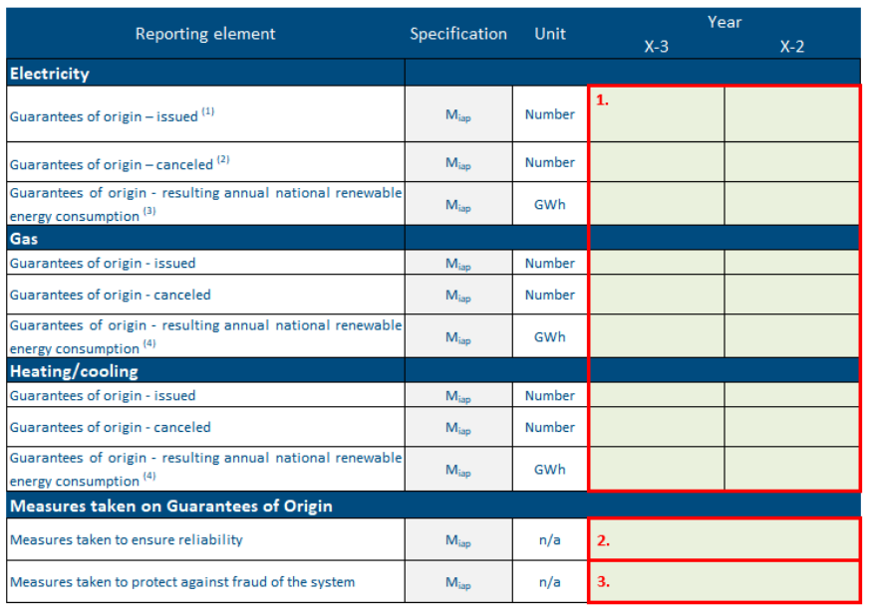
Annex 16 – Table 1
Functioning of the system of guarantees of origin for electricity, gas and heating & cooling from RES
FIELD 1: to indicate the details of the guarantees of origins for energy generated from renewable energy sources for electricity, gas and heating & cooling, including the following elements:
• Number of guarantees of origin issued for energy that is produced from renewable energy sources in the Member State during the reporting period.
• Number of guaranteed of origins cancelled for energy that is consumed in the Member State during the reporting period.
• The resulting annual national renewable energy consumption in GWh
(formulas in the Guidance)
number (integer)
number (decimal)
Notes:
Member States are obliged to have established a system to issue Guarantees of Origin of both electricity, gas and heating/cooling when RES producers request them, but exceptions can apply, for e.g., supported RES production or minimum capacity limits (article 19 of RED II).

Slide 27
Annex 16 – Table 1
Functioning of the system of guarantees of origin for electricity, gas and heating & cooling from RES
FIELD 2: The purpose is to present measures taken by the CPs to ensure the reliability of the system of guarantees of origin for electricity, gas and heating & cooling from renewable sources. Reliability mechanisms are required according to article 19 (6) of RED II.
If the measures taken correspond to a legal act (law, decree, regulation, etc.), it is good practice to report its full name in the national language and in English, and provide a link to the Official Journal.
FIELD 3: The purpose of this field to present measures taken to protect against fraud of the system of guarantees of origin for ..[].Mechanisms to prevent fraud are required according to article 19 (6) of RED II.
number (integer)
number (decimal)
text

Slide 28
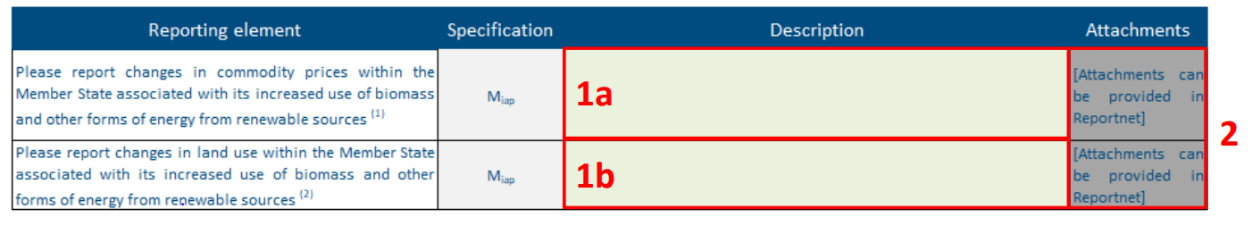
Annex 16 – Table 2
Changes in commodity prices and land use associated with use of biomass and other forms of energy from renewable sources
text
text
The purpose of these fields is to report additional detailed information of the changes in commodity prices and land use due to feedstock used for bioenergy production (reported in Table 6, Annex II).
The changes must be associated with an increased use of biomass and other forms of energy from renewable sources on an annual basis, as indirect land-use change is evaluated on an annual basis (see (EU) 2019/807).

Slide 29
Annex 16 – Table 2
Changes in commodity prices and land use associated with use of biomass and other forms of energy from renewable sources
Changes in commodity prices include changes associated with:
• Shifts in prices related to food and feed crops used for bioenergy.
• Shifts in prices related to mounting solar panel systems on the ground;
• Shifts in prices related to increased demand for forest biomass;
The changes in land use only concern changes in land used for biomass consumed for energy or ground mounted solar panel system installed on agricultural land. They do not include changes in all agricultural land.
Notes:
1: To determine/reduce the influence of other factors on the agriculture commodity prices dynamics, this data is to be supported by total land used to produce the feedstock (in ha), total annual yield (in tonnes), net trade balance of the feedstock (in tonnes) and share of feedstock in the net trade balance used for bioenergy for each feedstock type, including energy crops (e.g. short rotation coppice, perennial grasses etc.);

Slide 30
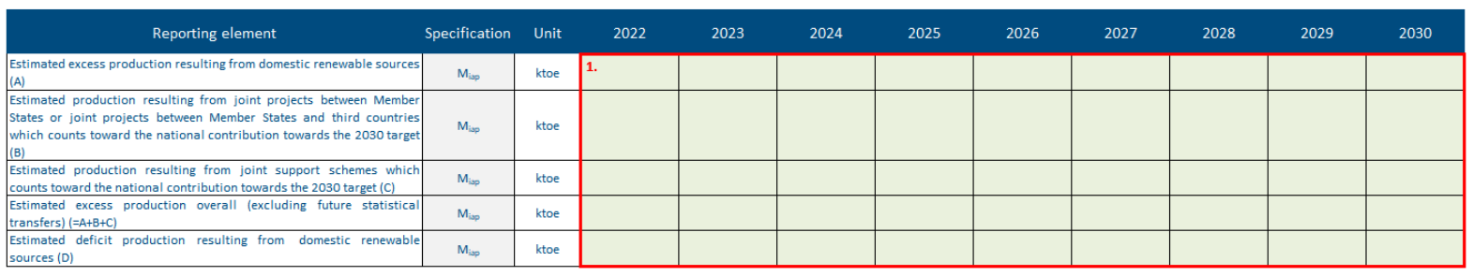
Annex 16 – Table 3
Estimated excess production of energy from renewable sources compared to the national trajectory towards the 2030 target
number (decimal)
negative number (decimal)
When available, the goal is to report the estimated excess production of energy from renewable sources (in thousand tonnes of oil equivalent, ktoe) resulting from:
• Domestic renewable sources;
• Joint projects between CPs, or CPS and MS, or joint projects between CPs and non-EU countries (which counts toward the national contribution towards the 2030 target);
• Joint support schemes (which counts toward the national contribution towards the 2030 targets).
Notes:
EX-SES

Slide 31
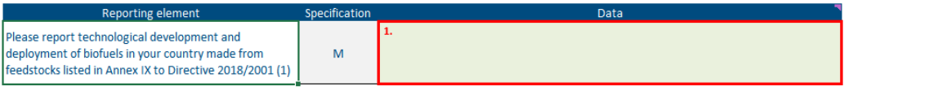
Annex 16 – Table 4
Technological development and deployment of biofuels made from feedstocks listed in Annex IX to Directive 2018/2001
text
FIELD 1: The purpose of this field is to report on the technological development and deployment of biofuels, as foreseen in the indicative national trajectory for mainstreaming the renewable energy in transport sector (Article 25, RED II).
In particular, to report technological development within their territories of biofuels made from feedstocks by listing the different technology pathways and give a description of their status in a qualitative manner:
• Development phase by technology readiness level (TRL)
• How close they are to market uptake (in years or date, if available)
• Recent developments (description)
• Investments or research funds acquired.
• Energy conversion efficiency (primary energy in feedstock vs final energy in biofuel)
• Own energy consumption (in ktoe), source (market, own supply) and type (fossil, renewable)
Notes:
The revised Renewable Energy Directive (‘RED II’), which is the main EU instrument dealing with the promotion of energy from renewable sources.

Slide 32
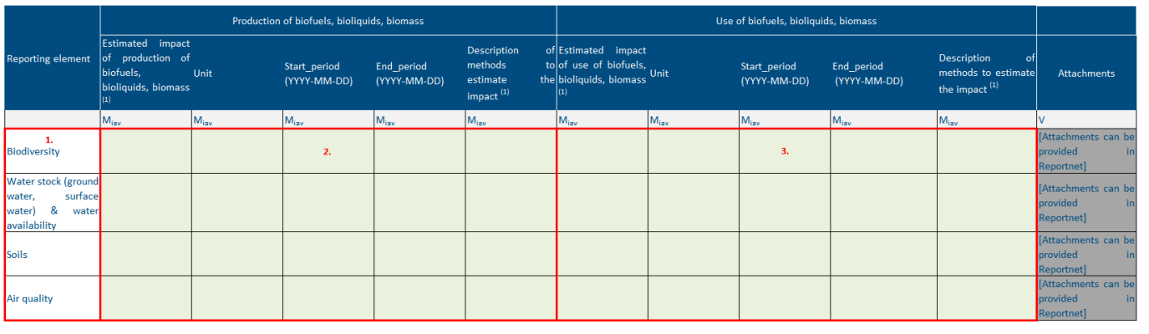
Annex 16 – Table 5
Estimated impact of the production or use of biofuels, bioliquids and biomass fuels on biodiversity, water resources and availability, soils and air quality
Mandatory, if available
The purpose is to provide the information when they have estimated impacts of the production/use of biofuels, bioliquids & biomass fuels on biodiversity / water resources and availability / soils / air quality

Slide 33
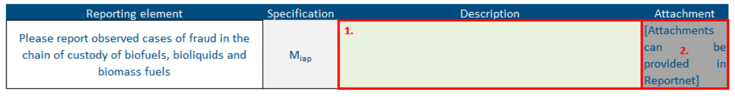
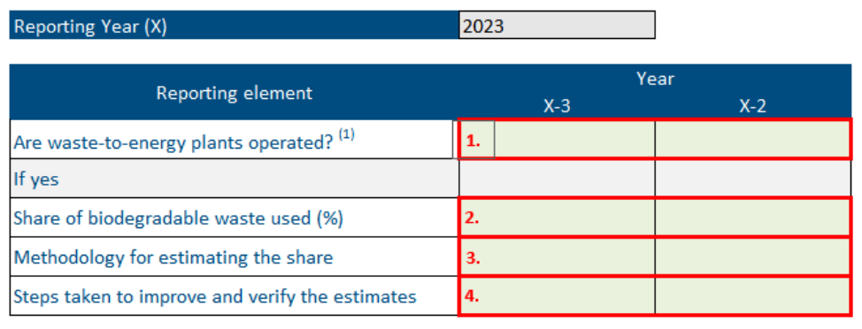
Annex 16 – Table 6 and 7
Observed cases of fraud in the chain of custody of biofuels, bioliquids and biomass fuels
Share of biodegradable waste in waste-to-energy plants used for producing energy
Mandatory, if applicable
Notes:
Biodegradable waste is defined as biodegradable garden and park waste, food and kitchen waste from households, restaurants, caterers and retail premises, and comparable waste from food processing plants. The share of bio-degradable waste used have to be calculated against total amount of waste used and have to be reported as a percentage (%).

Slide 34
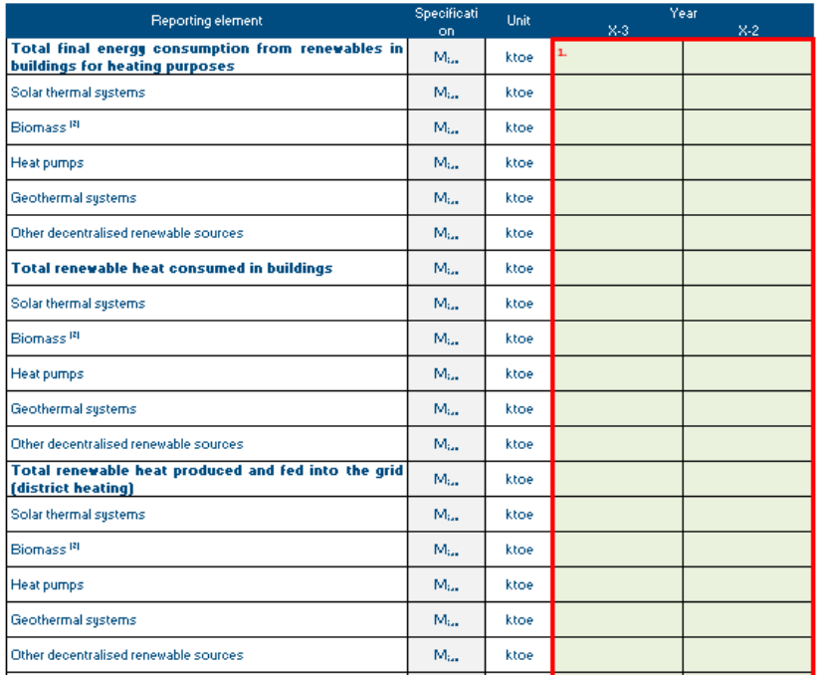
Annex 16 – Table 8
Electricity and heat generation from renewable energy in buildings, including, where available, disaggregated data on energy produced, consumed and injected into the grid
The data on energy from renewable energy generated in buildings have to be disaggregated for production / consumption / injection into the grid according to the following fields:
• Final energy consumption from renewables in buildings for heating purposes. This means e.g. biomass directly combusted in households. It excludes heat produced from renewables in e.g. district heating installations that is afterwards sold to households or services (if we assume that buildings includes both households and services).
• Renewable heat consumed in buildings, it includes only heat produced from renewables in a district heating installation and afterwards sold to buildings
• Renewable heat produced and fed into the grid
• Renewable electricity production in buildings
• Renewable electricity consumption in buildings
• Renewable electricity fed into grid
Notes:
About RE produced and use in buildings

Slide 35
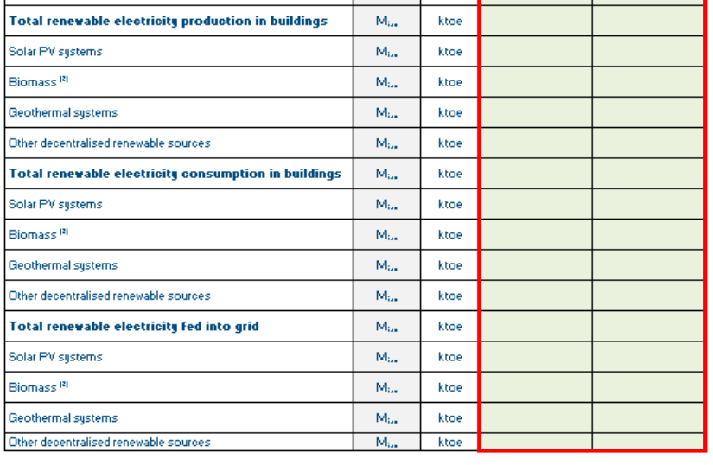
Annex 16 – Table 8
Electricity and heat generation from renewable energy in buildings, including, where available, disaggregated data on energy produced, consumed and injected into the grid
Progress reported has to include separate values for different renewable sources in each category (and for the total of each category):
• Solar thermal systems (only for heating reporting elements)
• Solar PV systems (only for electricity reporting elements)
• Biomass (as defined in RED II and following the Sustainability and greenhouse gas emissions saving criteria for biofuels, bioliquids and biomass fuels stipulated in Article 29 of Directive 2018/2001/EU)
• Heat pumps (only for heating reporting elements)
• Geothermal systems
• Other decentralised renewable source
Notes:
Buildings approximation in energy statistics
Dedicated statistics on buildings is the best way to ensure high quality information on buildings. In the absence of such statistics, estimates and modelling could be used.

Slide 36
Key takeaways
Follow Colour-coding: Ensure correct interpretation of cells in import/export Excel tables.
Reviewing EUROSTAT DATA you submitted
Use notation keys
Follow thematic guidelines for consistency
Engage Ensure validation before submission with the QA/QC process for high-quality data
Try to validate when you are sure you have done a good job.

Slide 37

First and second QAQC
Progress to target
30 Automatic QA/QC
6 “blocker” type QA/QC
24 “error” type QA/QC
Additional Reporting
81 Automatic QA/QC
14 “blocker” type QA/QC
49 "error" type QA/QC
18 "warning" type QA/QC
Manual checks for each CP
Completeness (20 checks): The purpose of this criterion is to verify that data has been reported for all non-voluntary fields;
Transparency (7 checks): The purpose of this criteria is to verify that data reported is understandable to most and univocal;
Accuracy (5 checks): Check if the values/information provided are accurate/plausible
Manual checks for All CPs
Comparability
the purpose of this criterion is to verify that the submitted data is comparable across CPs.
Coherence
the purpose of this criterion is to verify that the submitted data is coherent in the context.
Data resubmission​
​
Notes:
I would like to highlight an aspect that characterizes our data analysis.
[..] We are able to perform additional checks on the criteria of compatibility and coherence, and this way, we can further improve the quality of your data.

Slide 38
Member States Experience
Notes:
Instead of going through the entire RP3 presentation, is there any step that is not clear? I will focus MORE on that one.
Logging in & set-up
Data input – overview
Data input – excel import
Data input – excel export
Quality assurance – validations
Release of data - submission

Slide 39
Reportnet 3 – How to report ?
Logging in & set-up
Notes:
Instead of going through the entire RP3 presentation, is there any step that is not clear? I will focus MORE on that one.
Logging in & set-up
Data input – overview
Data input – excel import
Data input – excel export
Quality assurance – validations
Release of data - submission

Slide 40
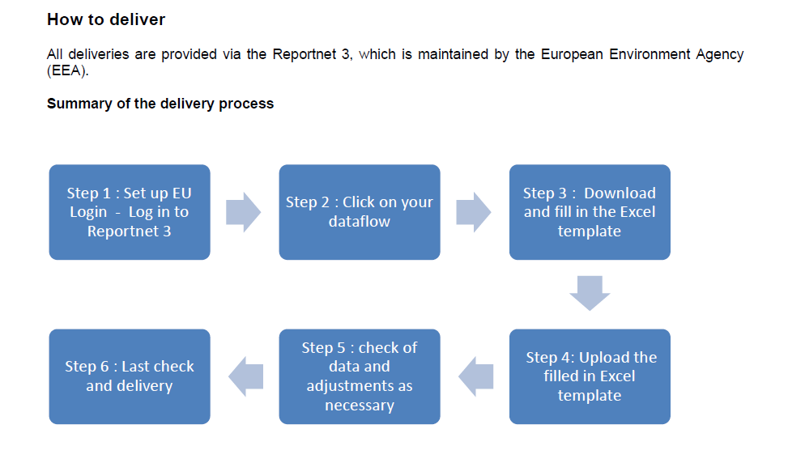
Notes:
Step 1 and 2 + generic Reportnet Intro => Marc

Slide 41
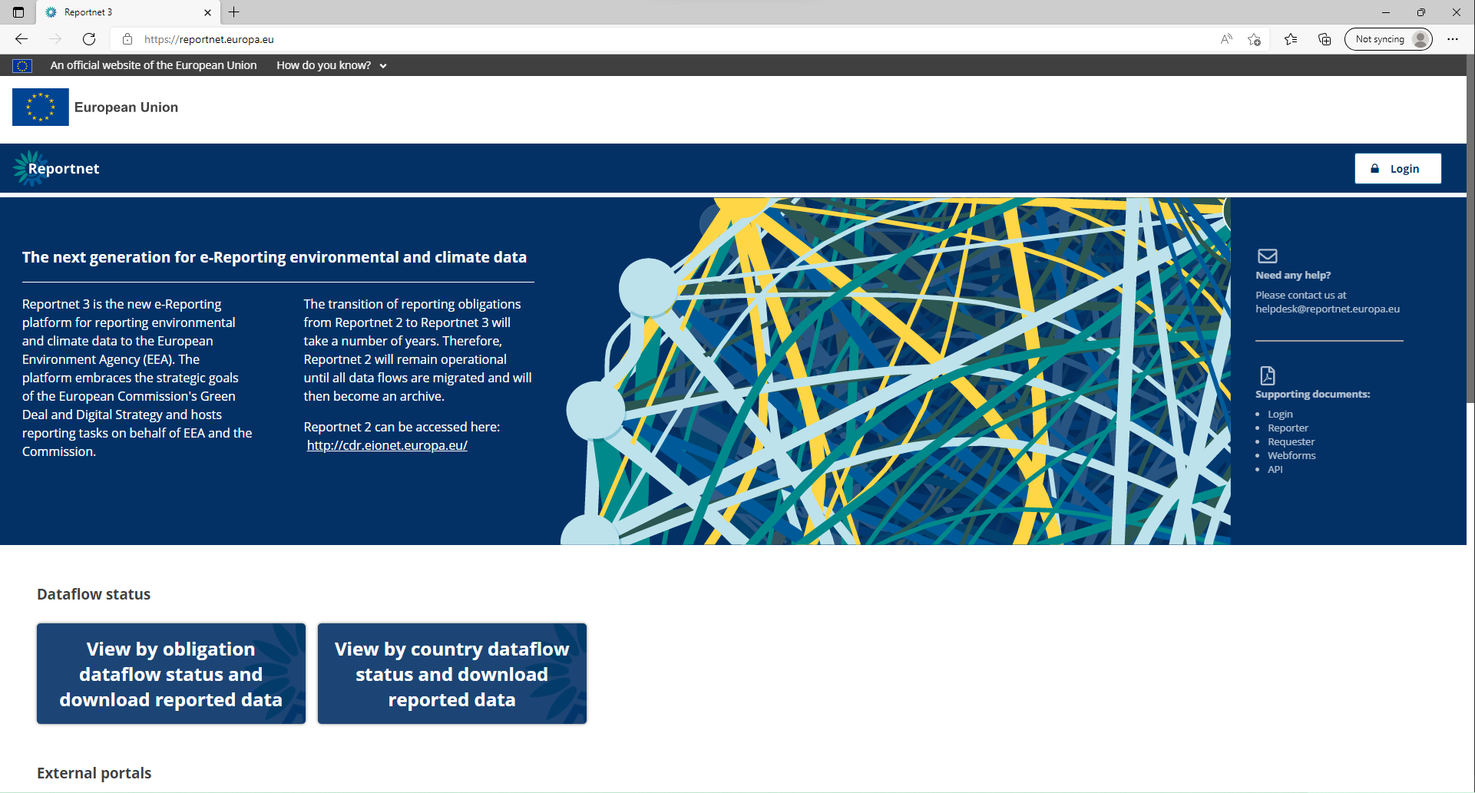
PaMs: Logging into Reportnet
Notes:
Marc

Slide 42
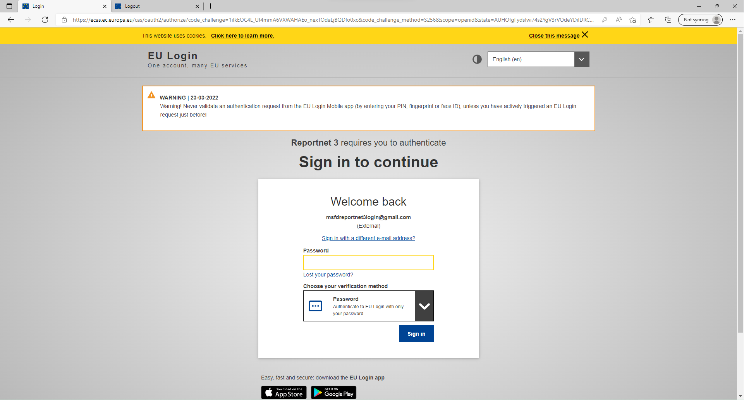
PaMs: Logging into Reportnet
Guidance on getting EU login and registering on the platform can be found in this document.
Notes:
Marc

Slide 43
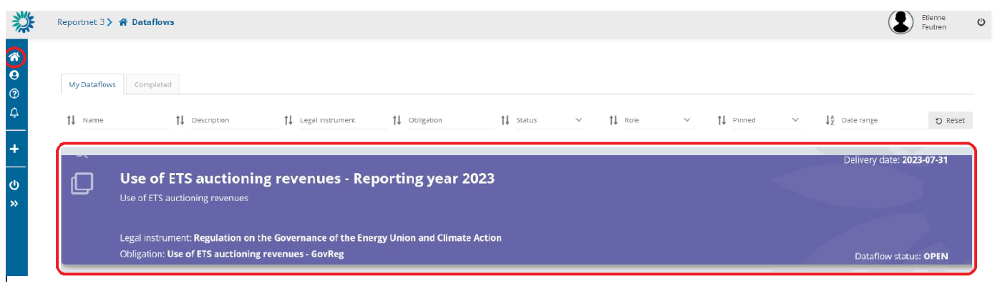
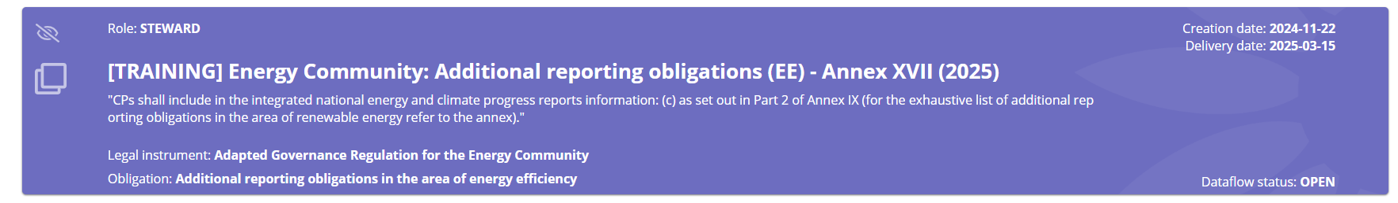
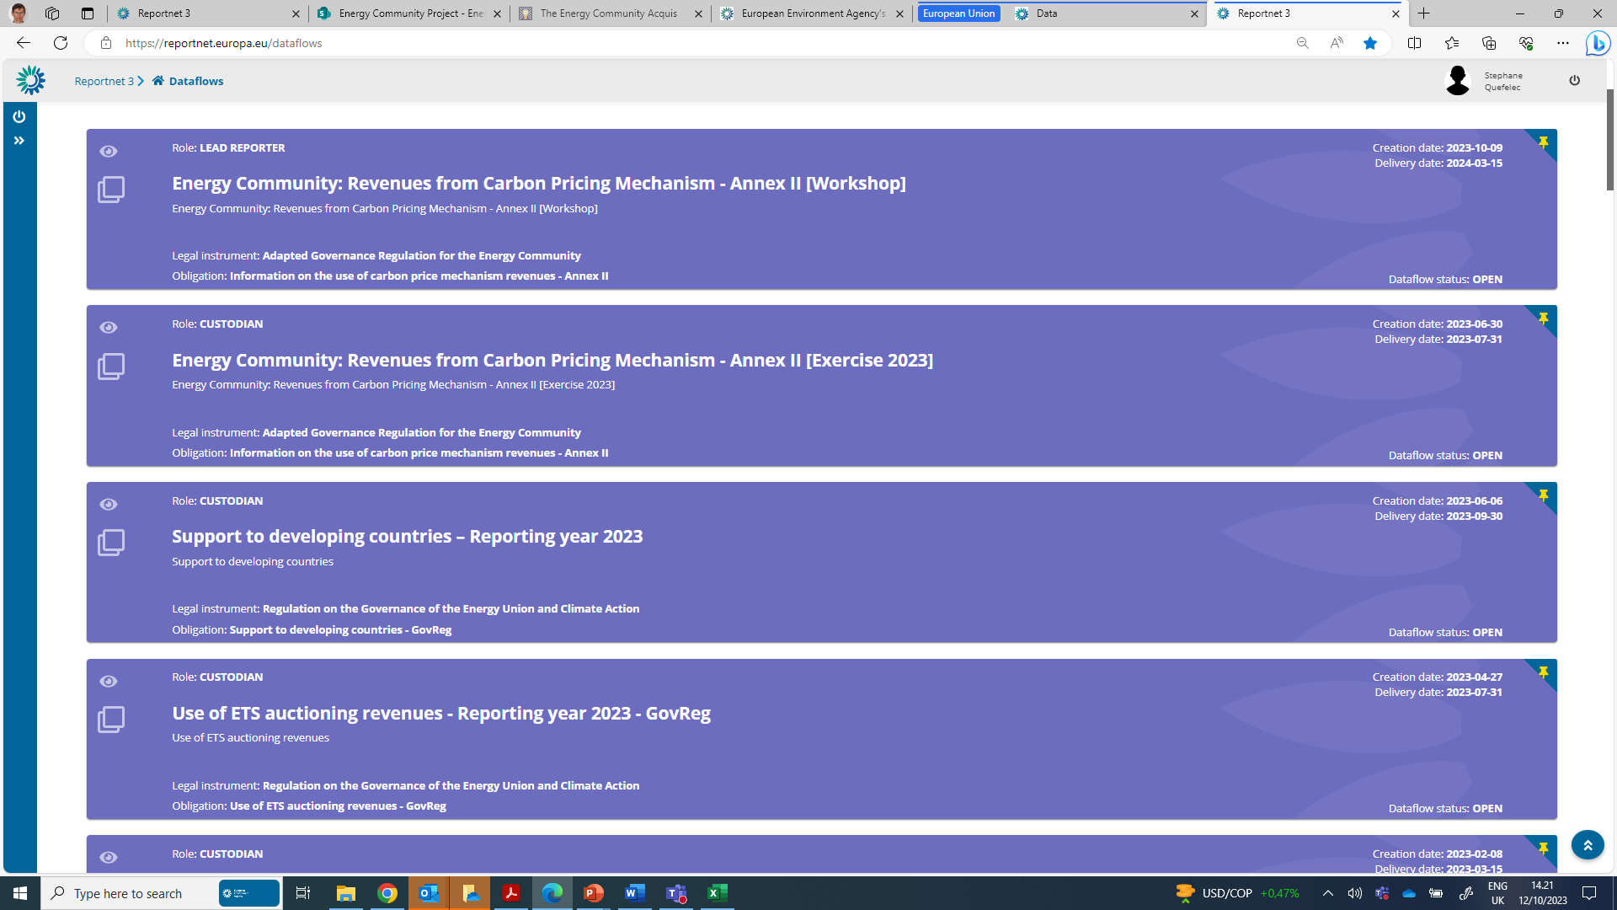
Reportnet 3.0 overview
Open dataflow: Purple
Closed dataflow: Grey
Notes:
Marc

Slide 44
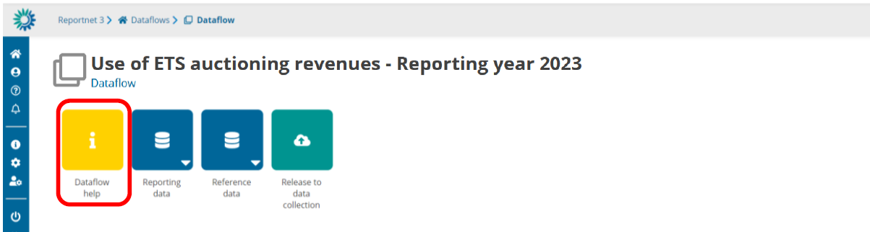
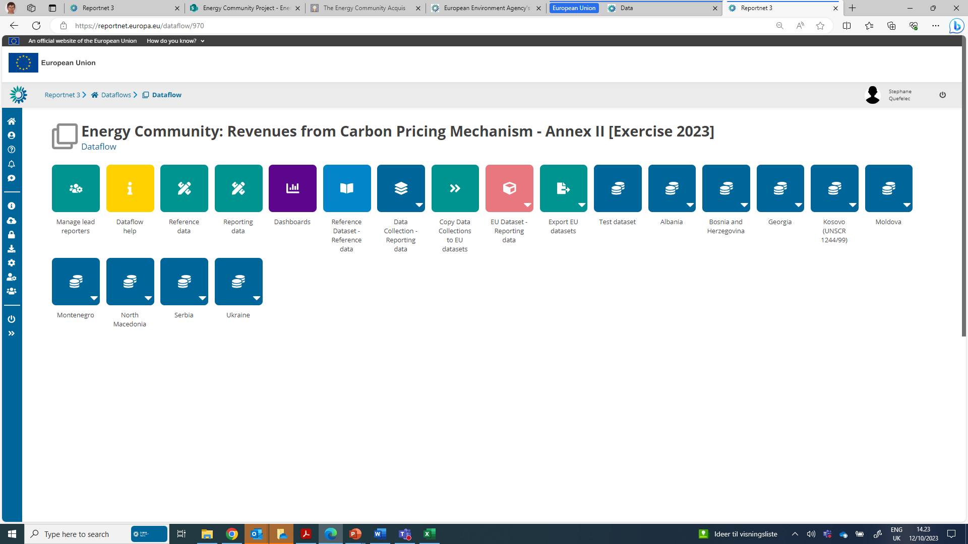
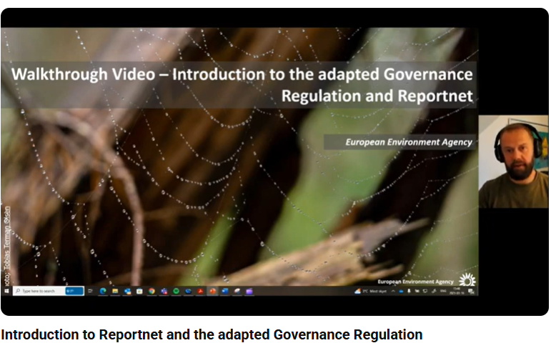

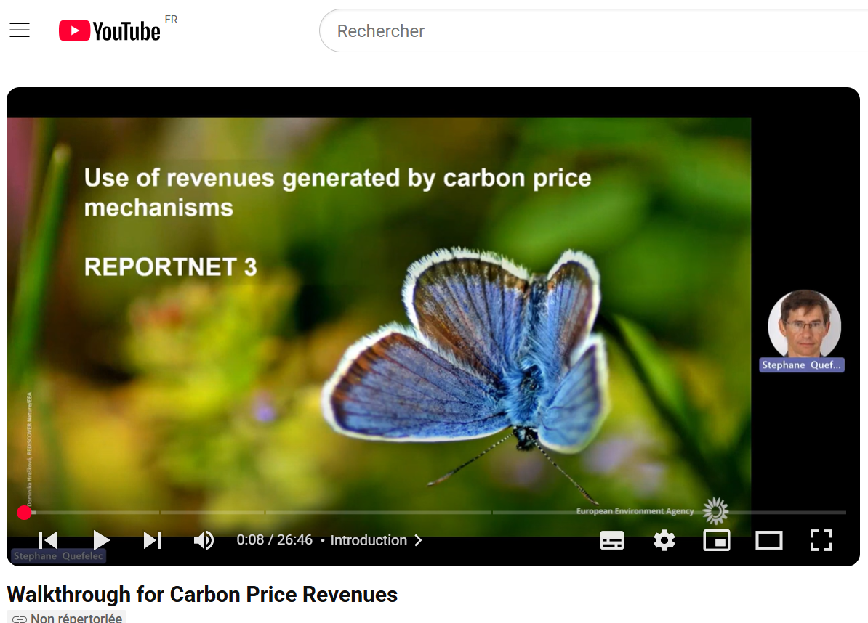
Reportnet 3.0 overview
Reporting guidance documentation
Import template
Useful weblinks
Download link(s)
Notes:
Marc

Slide 45
Notes:
Stephane

Slide 46

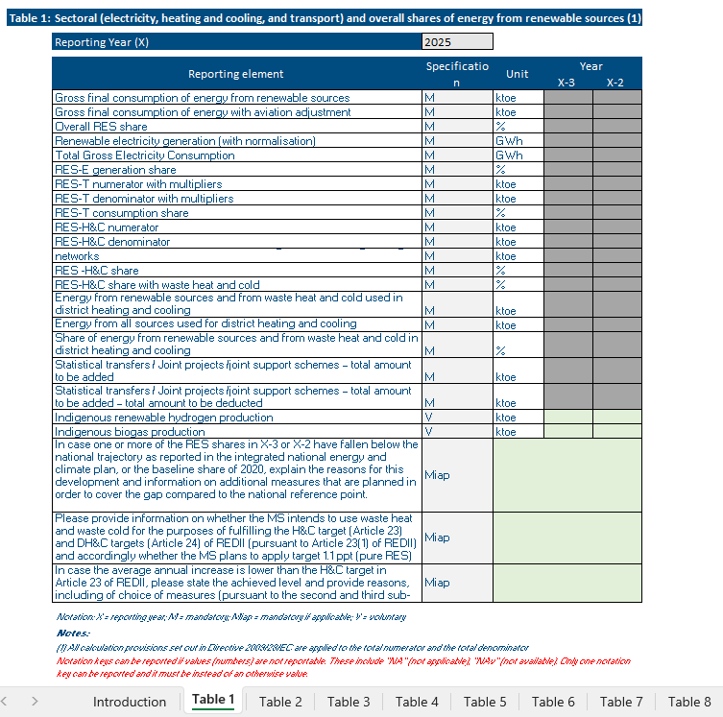
Reportnet: Excel import / Reportnet 3 tabular editing
Excel import
Easy to use - Excel follows structure of legislation.
Prefilling/Post-filling overview - Highlights where data should be reported (green cells) and where no reporting in Reportnet 3 is required (grey cells – prefilled / post-filled).
Risk – If import not used correctly can cause issues on the finally imported data to Reportnet 3.
Do not edit data formats / structures – be careful when copying and pasting!
Excel import does not equal reporting – reporting is only considered complete once an official submission in the platform is made. Therefore, once data is imported, quality checks and final check of data is required!

Slide 47
Notation keys
What is a Notation Key?
A system to clarify lack of numerical data (where unavailable or not applicable).
Required for mandatory if applicable (Miap), if available (Miav), or voluntary (V) reporting.
Notation key | Description
NA | Not applicable - For data and activities in a reporting country that are not applicable or relevant to the context of the reporting country. Anticipated to be used in the context of Miap and V reporting fields. This notation key can be used instead of a value or 0, to ensure complete reporting.
NAv | Not available – For data and activities in a reporting country that are applicable to the context of the reporting country, however the data is not available. Anticipated to be used in the context of Miap, Miav and V reporting fields. This value can be used instead of a value or 0, to ensure complete reporting.
C | Confidential – Specifically for Annex II, Table 5, reporting on greenhouse gas savings performance of biofuels. This notation key is for data and activities in a reporting country that are available but are confidential and therefore cannot be reported publicly at a disaggregated level.
Import templates provide overview of when notation keys are accepted
For any issues check the reporting guidelines!
GHG (Annex I)
RES (Annexes II & XVI)
EE (Annexes IV & XVII)
Applicable to these dataflows

Slide 48



Validation
Import functionality
Reportnet 3 (europa.eu)

Slide 49
Step 4: Upload the filled in Excel template
2 - Check status
1- Import your data following instructions
3 - Refresh
Notes:
Marc
Step 4: Upload the filled in Excel template.
Once populated, you need to upload your filled in Excel template.
From the “Reporting data” page, click on “Import dataset data” (see the red rectangle below) and follow instructions.
When you click on “Upload”, the data included in the Excel template will automatically be pushed to the web platform. The system will inform you how the uploading is running using pop-up windows on the upper right corner of the screen.
It may take some time; a little bit of patience might be required; this is because the system runs a certain number of checks on your data.
You can also see the status of uploading in the “Notifications” (bell icon) on the left side.
If you do not see your data, use the “Refresh” button on the right-hand side. You can then check that the information is correctly transcribed in the different tables, which can be consulted with the corresponding tabs.

Slide 50
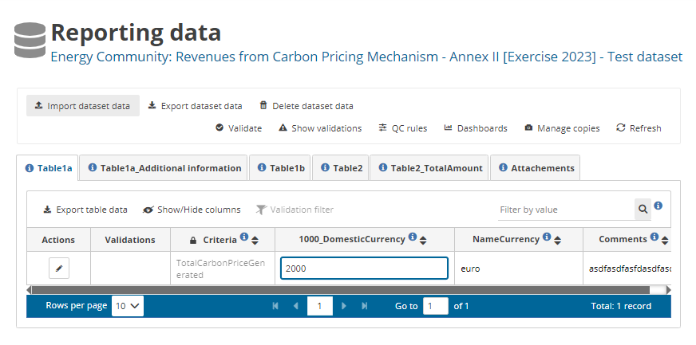
Step 5 : check of data and adjustments as necessary
Validating and correcting data
- Validate data and adjust as necessary
- Errors/warnings can be addressed directly in Reportnet3 or in the reporting template (which then needs to be uploaded again –remember to replace data)
1- Validate
2 - Refresh
3 – correct/adjust
Notes:
Marc

Slide 51
Annex 2 & 16 – QAQC
QA/QC (checks) on the reporting platform Reportnet 3
Progress to target
30 Automatic QA/QC
6 “blocker” type QA/QC
24 “error” type QA/QC
Additional Reporting
81 Automatic QA/QC
14 “blocker” type QA/QC
49 "error" type QA/QC
18 "warning" type QA/QC
Internal Automatic and Manual QAQC ( Annex XXVI, Additional Reporting)
EUROSTAT Datasets for the Enhancement of Quality Assurance
NRG_IND_PEHCF: Gross production of electricity and derived heat from combustible fuels by type of plant and operator
NRG_IND_URHCD Use of renewables for heating and cooling - details
NRG_IND_PEHAP Production of electricity and heat by auto producers, by type of plant
SDG_07_40 Share of renewable energy in gross final energy consumption by sector
Notes:
Annex 16: Miha: For table 7 reference from EUROSTAT is table NRG_IND_PEHCF. For Table 8 we use NRG_IND_URHCD, NRG_IND_PEHAP and SDG_07_40. Values from the first table are used as they are (since it reports use of renewables in heating and cooling and one of reported values in XVI is Final energy consumption from renewables in buildings for heating purposes) and the rest are used to calculate values used for comparison. Here we don’t have very reliable reference values, so we are limited to check if value is within range of expected values.

Slide 52



Validations – types of errors
Warning (can release data)
Error (can release data)
Blocker (can’t release data)

Slide 53
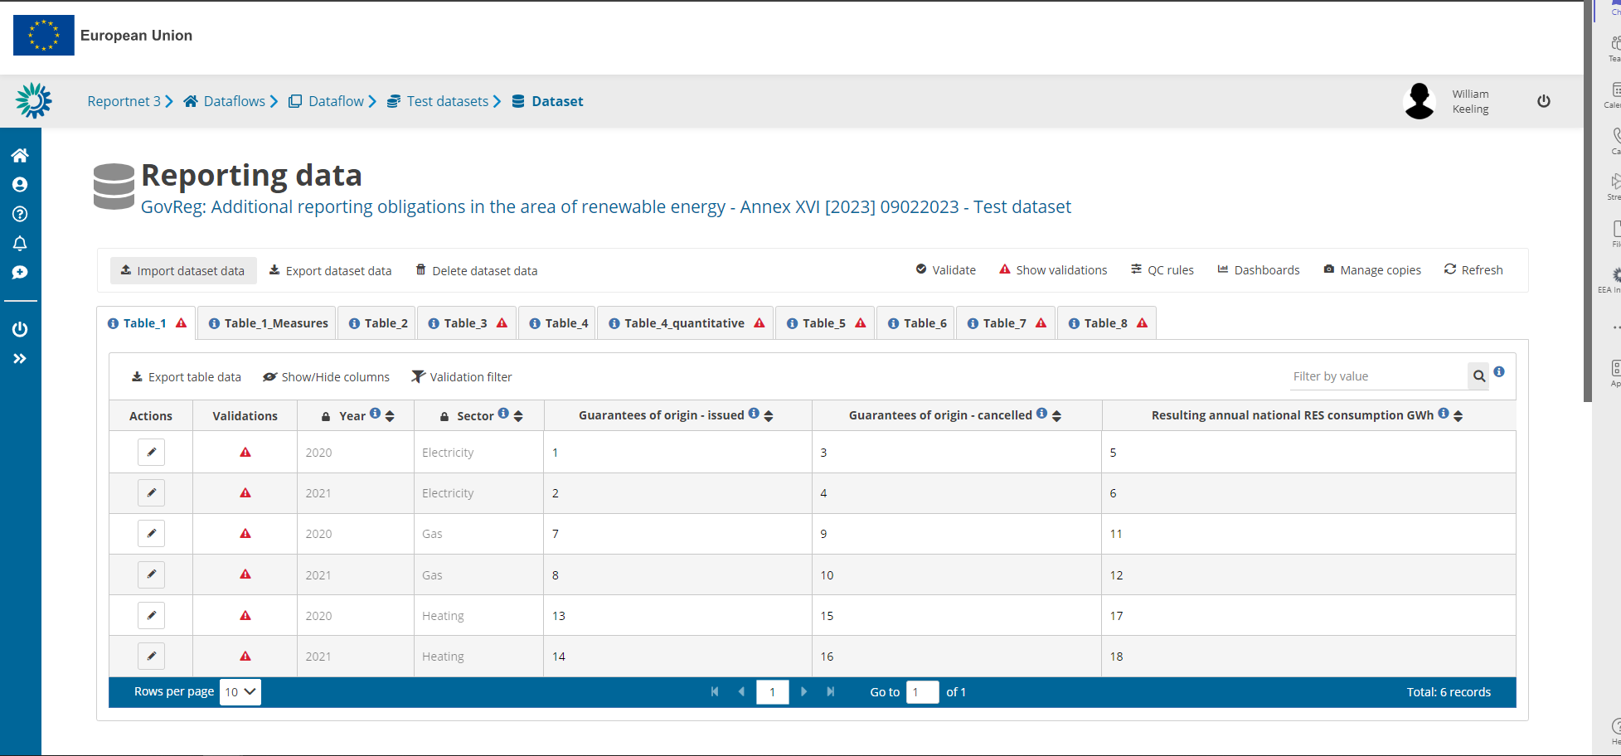
Validations – reviewing errors in the dataflow
Add any number of slides for print screens for this Section
1. Table level errors
2. Record level errors
3. Specific errors

Slide 54
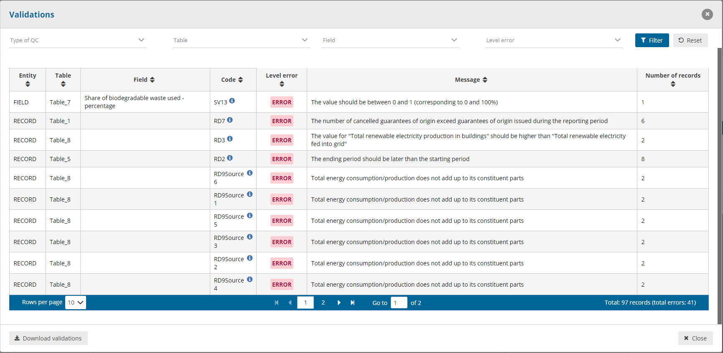
Validations – overview of errors in dataset
Filtering options available here
To view all validations in dataflow
Download validations in a csv. here

Slide 55
Step 6 : release
Submitting data
After addStep 6 : Last check and delivery
ressing all error/warning messages, again validate and refresh the data
When reporting is finalised, release the data
Notes:
Marc

Slide 56
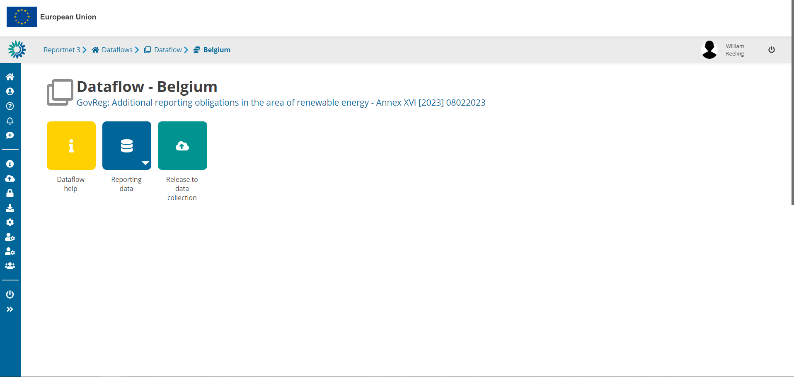
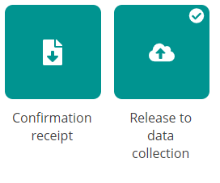
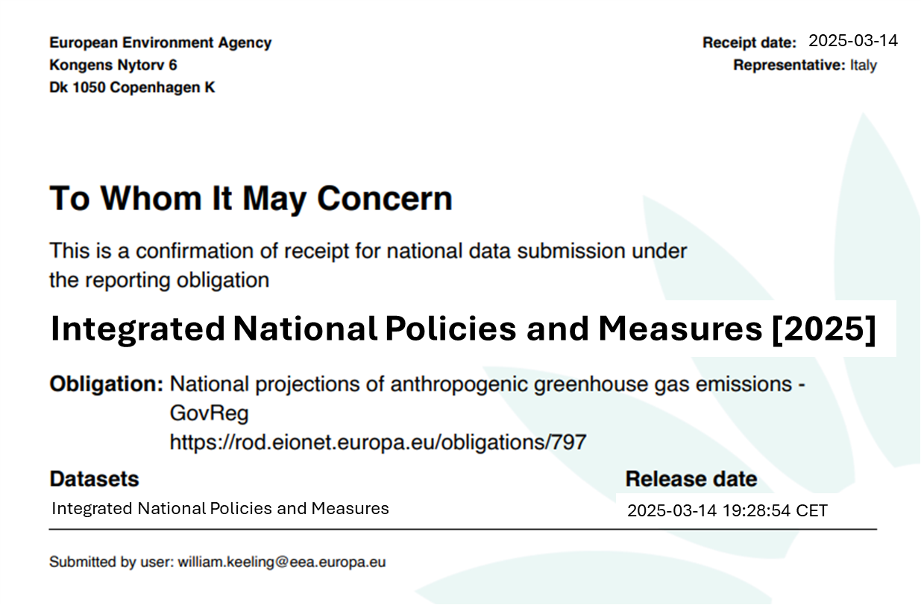
Data submission
Add any number of slides for print screens for this Section
Releasing data can take a while
This can run in the background while you do other tasks!
! If the confirmation receipt does not appear a blocker remains in your dataflow and must be resolved before releasing again !

Slide 57

Next steps
Quality assurance and final datasets

Slide 58



Next steps – submission, quality checks, assessment
Deadline for reporting:
15 March 2025
Quality assurance:
15 March – 15 June
Final dataset:
End June
Assessment & analysis:
July – October
It will not be possible to extend after August (6 weeks needed before).

Slide 59
First and second QAQC
Progress to target
30 Automatic QA/QC
6 “blocker” type QA/QC
24 “error” type QA/QC
Additional Reporting
81 Automatic QA/QC
14 “blocker” type QA/QC
49 "error" type QA/QC
18 "warning" type QA/QC
Manual checks for each CP
Completeness (20 checks): The purpose of this criterion is to verify that data has been reported for all non-voluntary fields;
Transparency (7 checks): The purpose of this criteria is to verify that data reported is understandable to most and univocal;
Accuracy (5 checks): Check if the values/information provided are accurate/plausible
Manual checks for All CPs
Comparability
the purpose of this criterion is to verify that the submitted data is comparable across CPs.
Coherence
the purpose of this criterion is to verify that the submitted data is coherent in the context.
Data resubmission​
​
Notes:
I would like to highlight an aspect that characterizes our data analysis.
[..] We are able to perform additional checks on the criteria of compatibility and coherence, and this way, we can further improve the quality of your data.

Slide 60
Next steps – quality checks
T
imeliness
T
ranspanrecy
A
ccuracy
ETC to prepare list of possibly quality issues (COMLOG) to be shared with CPs after 15 March.
CPs requested to resubmit data officially in Reportnet 3.
ETC-EEA will only make updates to final dataset in communication with CPs.
Final quality reports will summarise final state of data and updates request for future reporting.
C
ompletness
C
onsistency
C
oherence & comparability

Slide 61


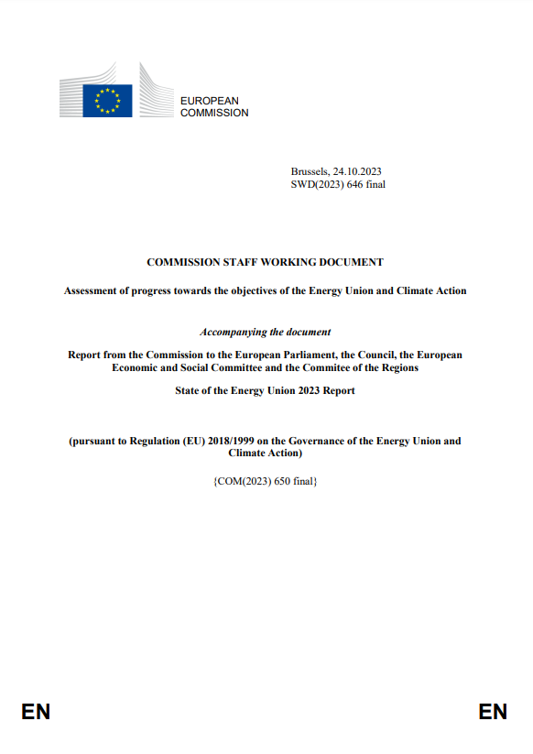



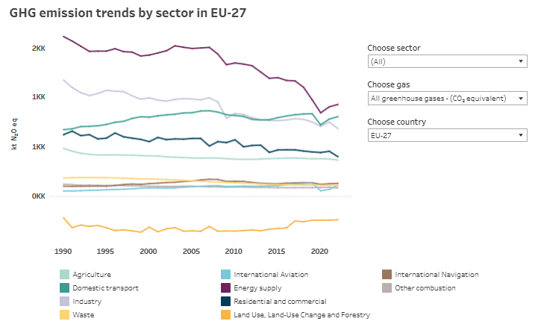
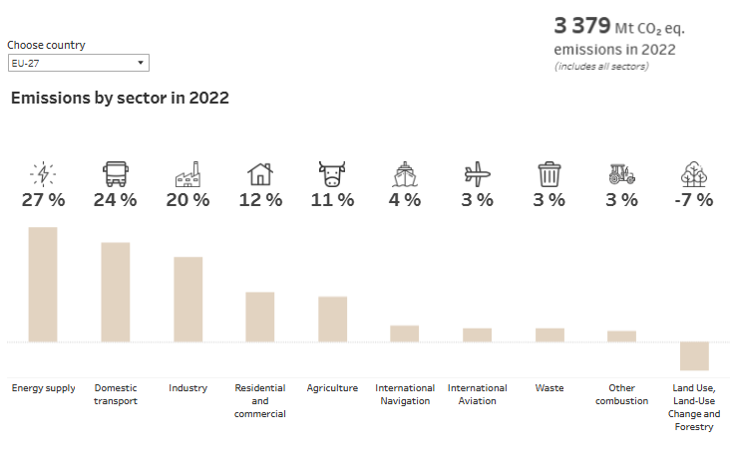
Next steps – assessment and analysis
Final datasets
EEA – datahub
European Commission
Assessments
State of Energy Union Report
NECPR technical assessment
Climate Action Progress Report
EEA
Analysis
Trends and Projections
SOER 2025
Dataflow quality reports
Data tools
Climate & Energy in the EU portal

Slide 62
If questions – please reach out!
For questions: magdalena.jozwicka@eea.europa.eu

Slide 63
Key takeaways
Follow Colour-coding: Ensure correct interpretation of cells in import/export Excel tables.
Reviewing EUROSTAT DATA you submitted
Use notation keys
Follow thematic guidelines for consistency
Engage Ensure validation before submission with the QA/QC process for high-quality data
Try to validate when you are sure you have done a good job.

Slide 64
Thank you
© Alice van Kempen, Well with Nature /EEA
Notes:
Closing slide: you may want to use the same image as in the opening slide and thank your listeners.

Slide 65

Exercise

Slide 66
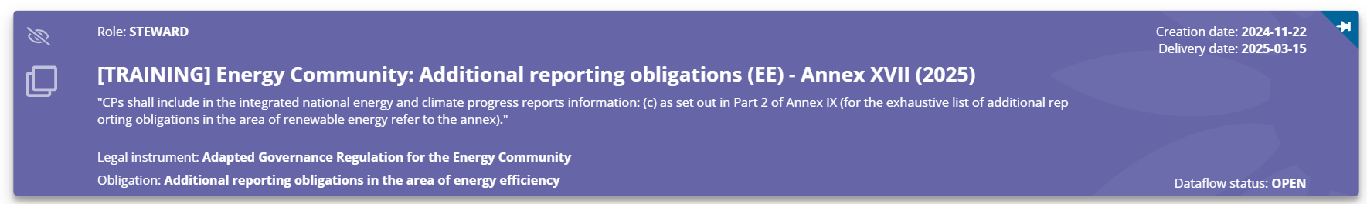
Exercise
Log into Reportnet, access the Annex II and open the reporting guidelines
Review the tables
Note any questions or concerns
If you have some national data, try to add and try to validation
If you don t have any data……invent them for the purpose of the exercise

Slide 67

Questions?
Answer the following questions as a group:
Are you able to identify the data needed?
Do you think you will manage to submit it?
For questions: magdalena.jozwicka@eea.europa.eu
Notes:
If you have any issues with the platform, questions, or would like to request any form of assistance from us, please do not hesitate to contact us. We will be happy to support you. I am sharing our emails here on this slide. You can reach out to me if you have any questions regarding reporting on climate adaptation, and you can reach out to my colleague Marc if you have any technical issues.

